Slide 1
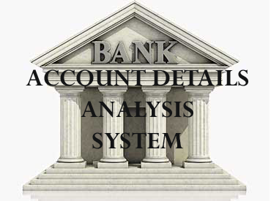

Slide 2

Project Team:
Priyanka Gaikwad
Karthik S
Sampath Siva Krishna
Kalaimagal
Sravan Kumar Talluru
Under the Guidance of
Mr. Rahul Kulkarni

Slide 3

Project Objectives:
Development of Analysis & Reporting System of Bank Account Details
Preparation of Reports in Power BI which will be used to analyze Bank Data as per requirements

Slide 4
Project Flow
EXTRACT
Heterogeneous Sources i.e. operational data (Flat files, Excel)
TRANSFORM
Data
warehouse
(MS SQL)
Reports Based
On Dataset
Dataset
LOAD
(SSIS)

Slide 5

Source Data
Employee Name
Employee Age
Marital Status
Company Name
Company Location
Bank Branch
Education
Housing
Loan
Reward Point
Account Numbers
Balance
Account opening Date

Slide 6
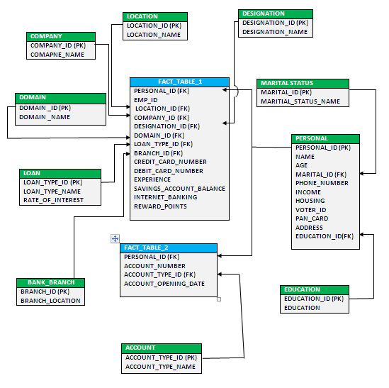
Data Warehouse SnowFlake Schema

Slide 7
Staging Tables
Source
(Bank Data)
Expression
(Type Casts, Trim and lower case)
Sort
Conditional Split
Error Table
Staging Area

Slide 8
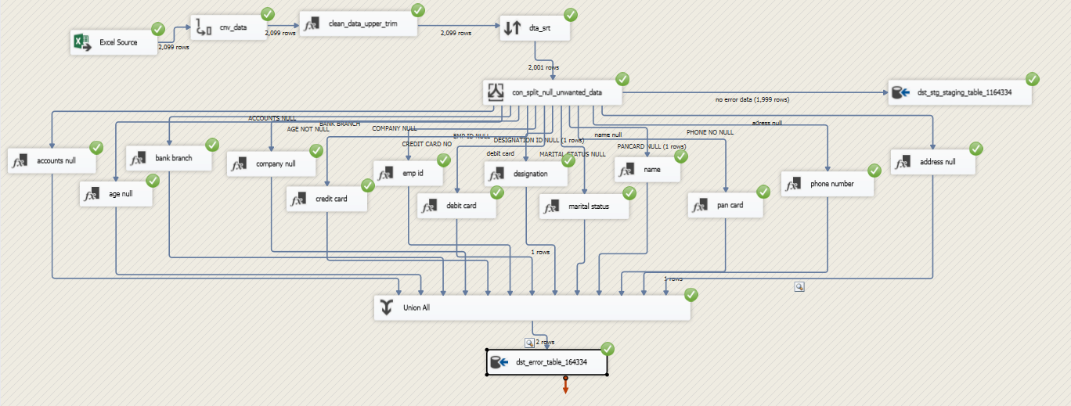
Data Staging

Slide 9
Creation of Dimension Tables
OLEDB Cleaned Data Tables
(Source)
Dim Domain
Dim Bank Branch
Dim Company Location
Dim Company Name
Dim Education
Dim Marital Status
Dim Personal Details
Dim Account Type
Flat File (Account Type)
Dim Designation Details
Flat File (Designation)
Dim Loan Type
Flat File (Loan Type)

Slide 10
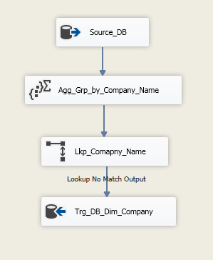
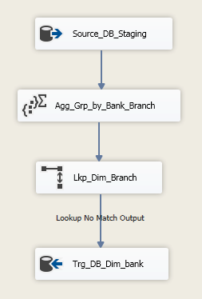
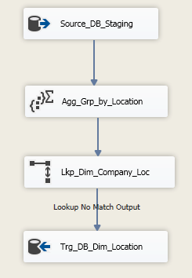
DimCompany
DimBankBranch
DimLocation

Slide 11
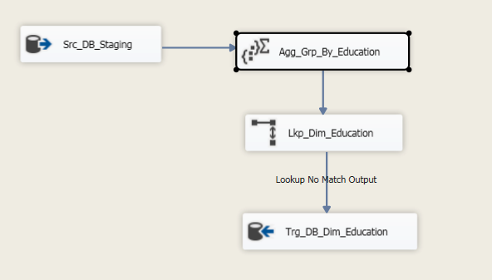
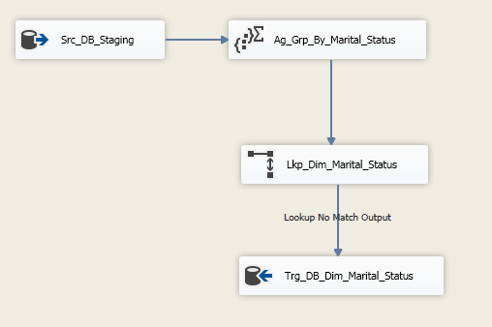
DimEducation
DimMaritalStatus

Slide 12
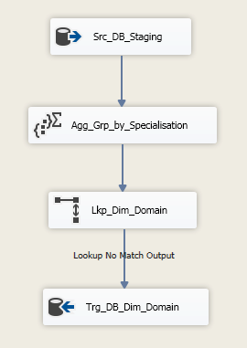
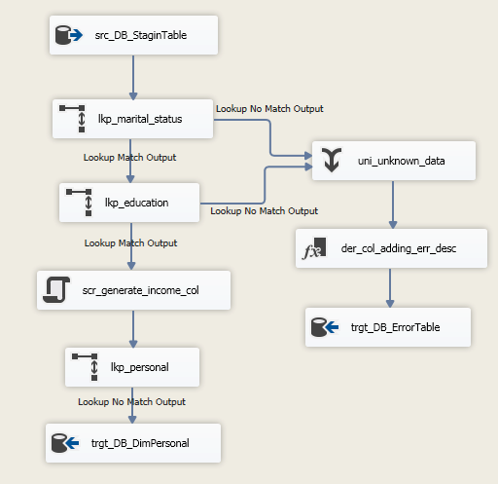
DimDomain
DimPersonal

Slide 13
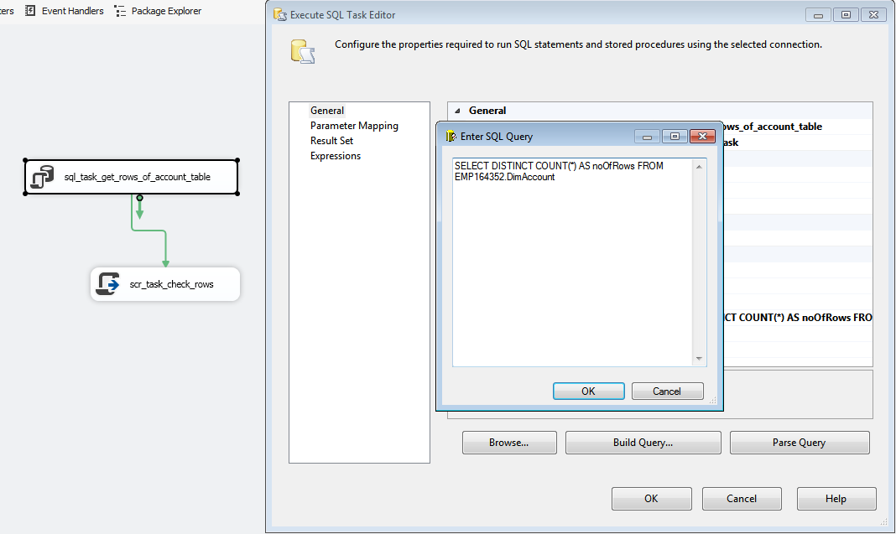
DimAccount, DimDesignation & DimLoan

Slide 14
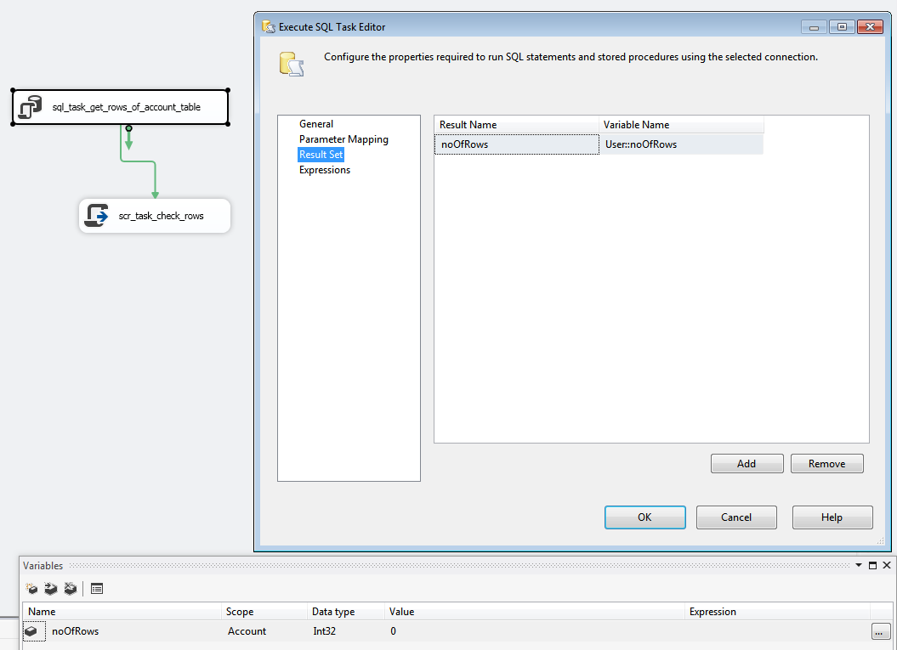
DimAccount, DimDesignation & DimLoan

Slide 15
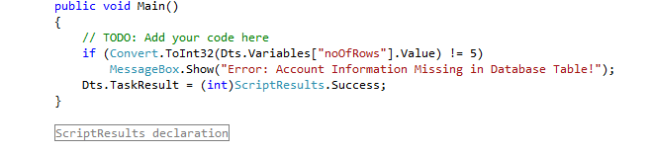
DimAccount, DimDesignation & DimLoan

Slide 16
Creation of Fact Personal Info
Source
(Staging Table)
Dim Personal Details
(Lookup)
Dim Company Location
(Lookup)
Dim Company Name
(Lookup)
Dim Domain
(Lookup)
Dim Branch Location
(Lookup)
Fact Table 1
(Destination)

Slide 17
Creation of Fact Account Info
Source
(Staging Table)
Dim Personal Details
(Lookup)
Un pivot Account
Number Data
Conditional Split
(removing Null values)
Fact Table 2
(Destination)

Slide 18
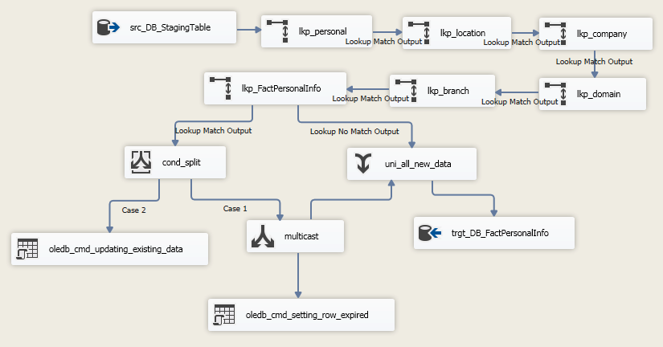
Fact Table 1 – (FactPersonalInfo)

Slide 19
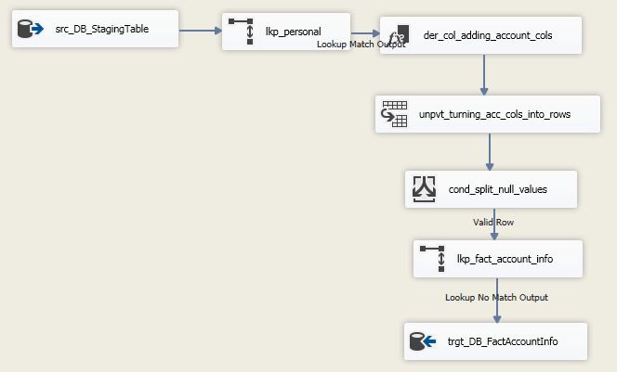
Fact Table 2 – (FactAccountInfo)

Slide 20
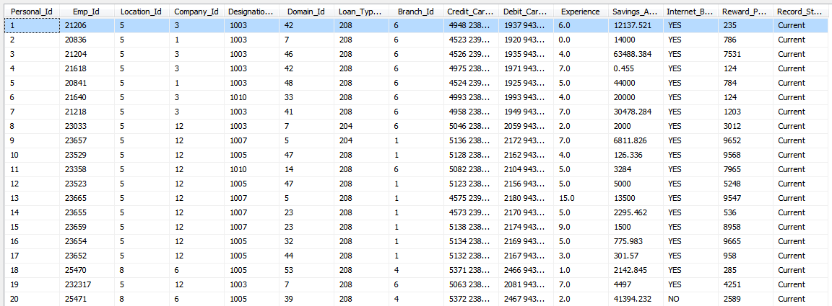
Fact Table 1 Data

Slide 21
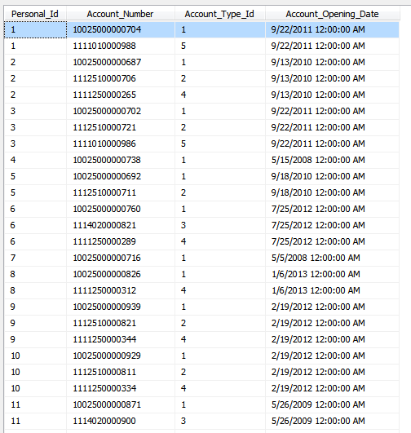
Fact Table 2 Data

Slide 22
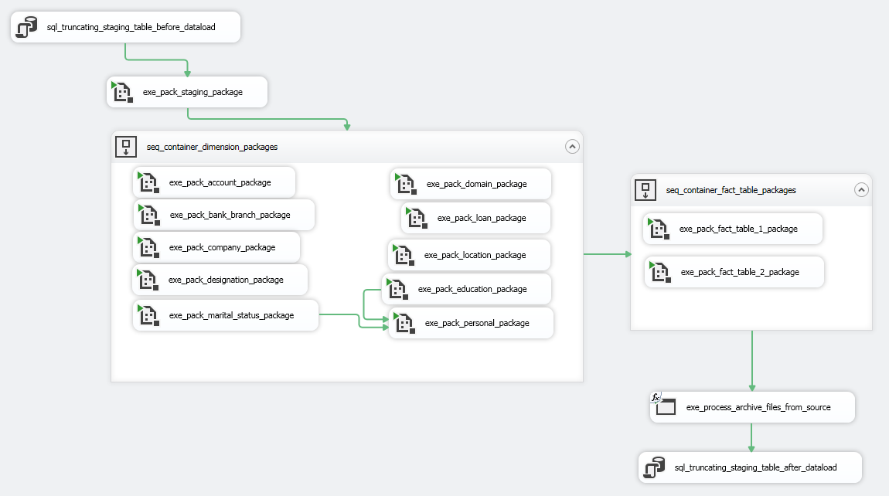
Master Package

Slide 23
Project Reports

Slide 24
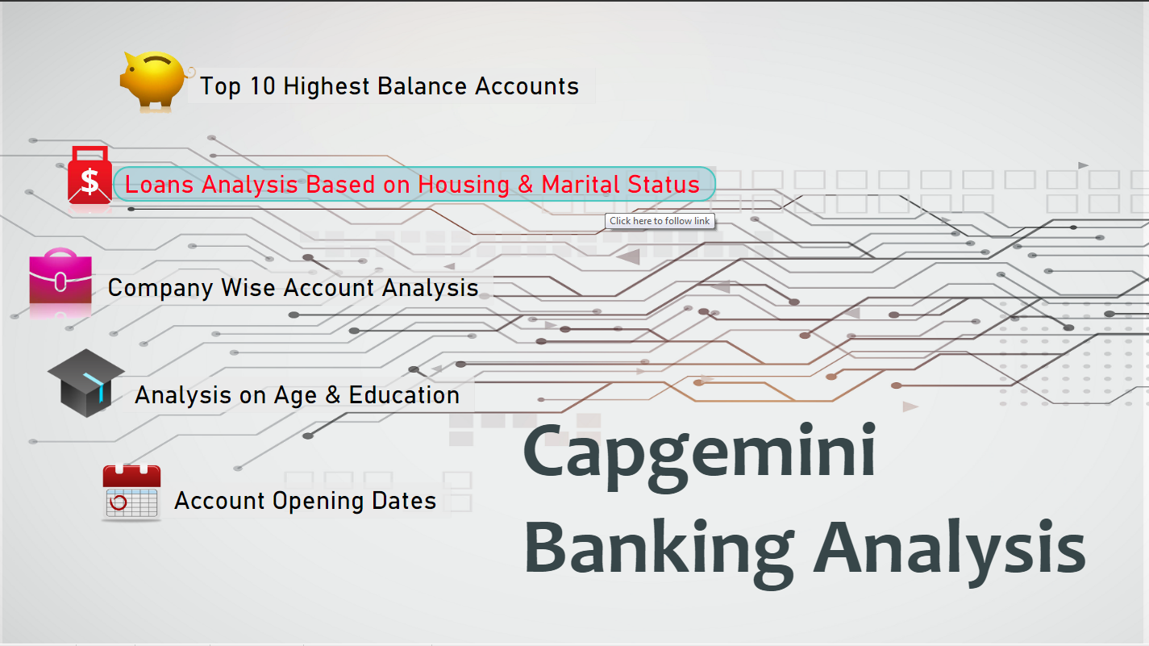
Index

Slide 25
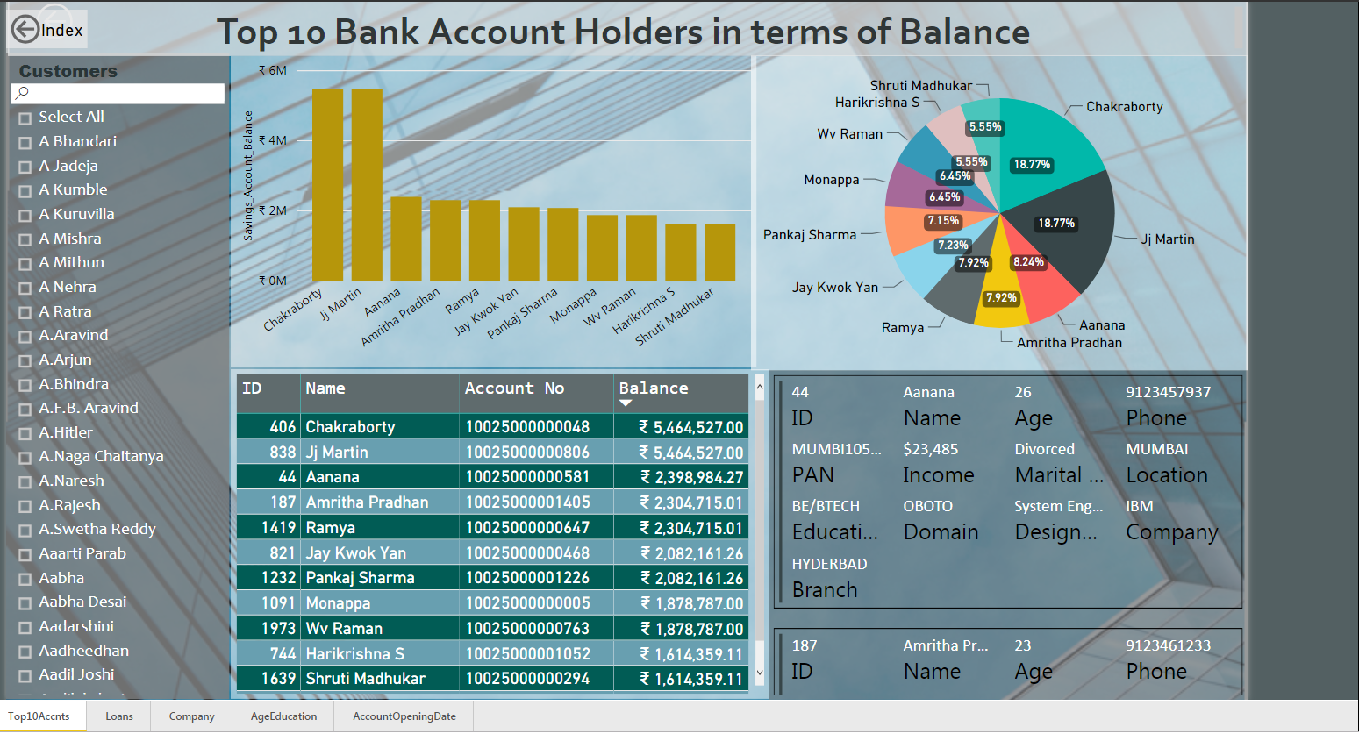

Slide 26
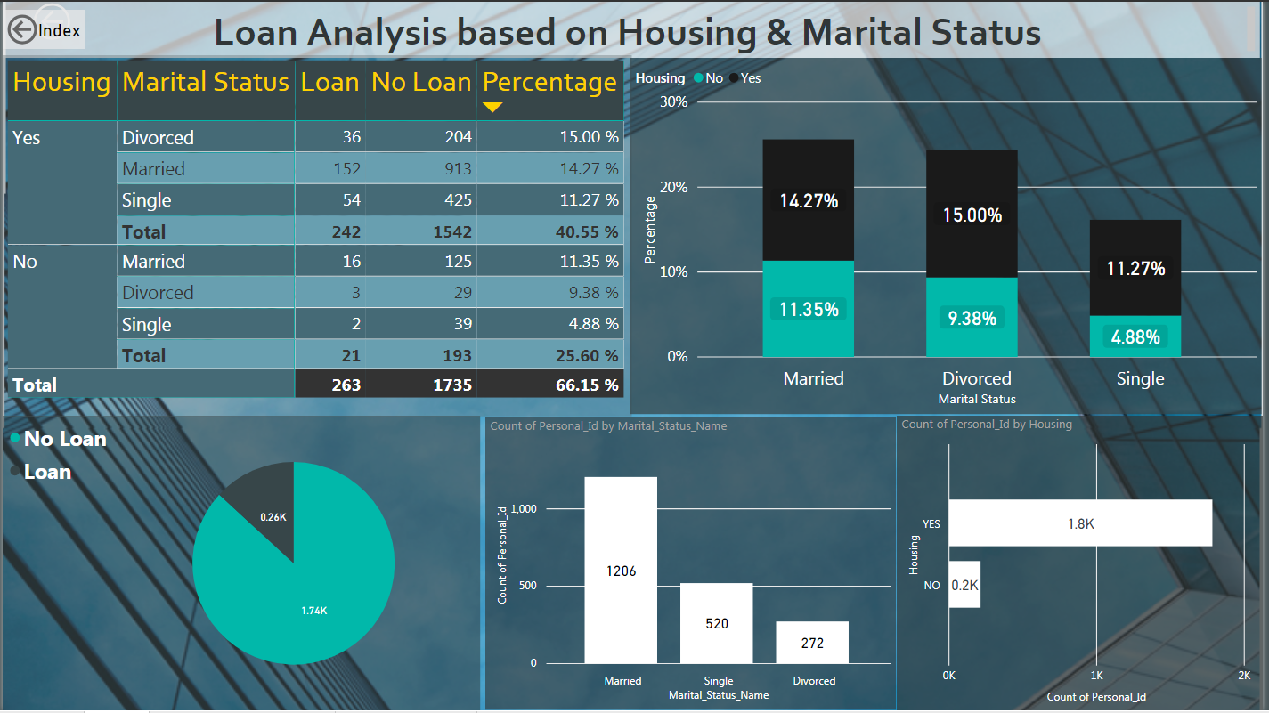

Slide 27
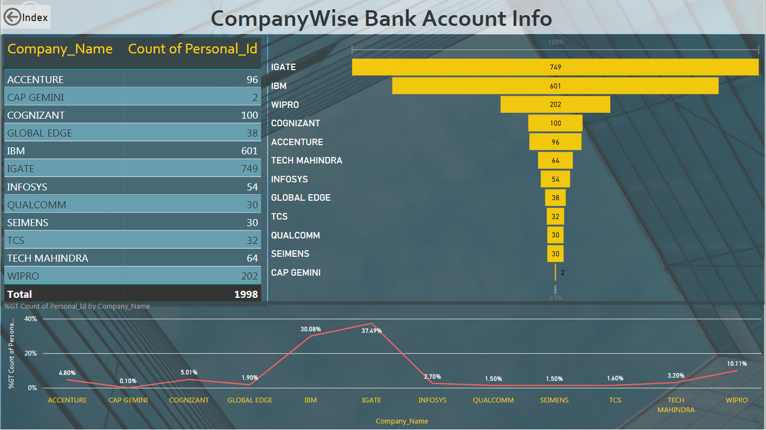

Slide 28
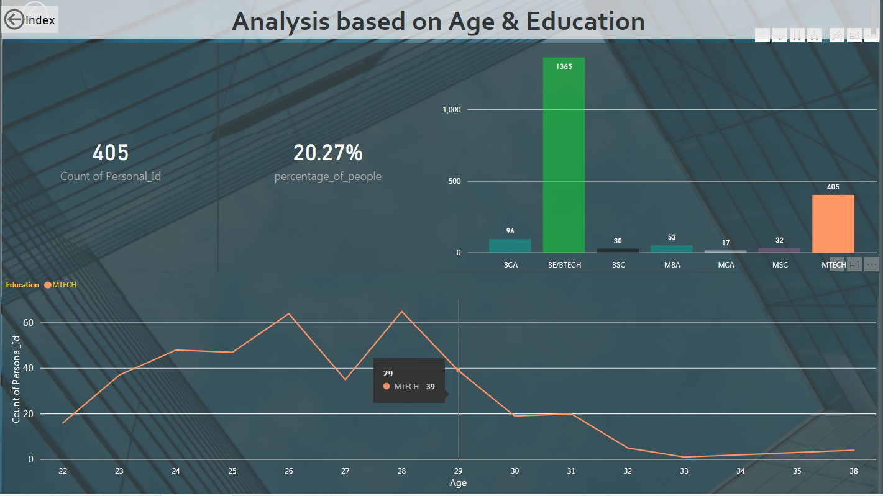

Slide 29
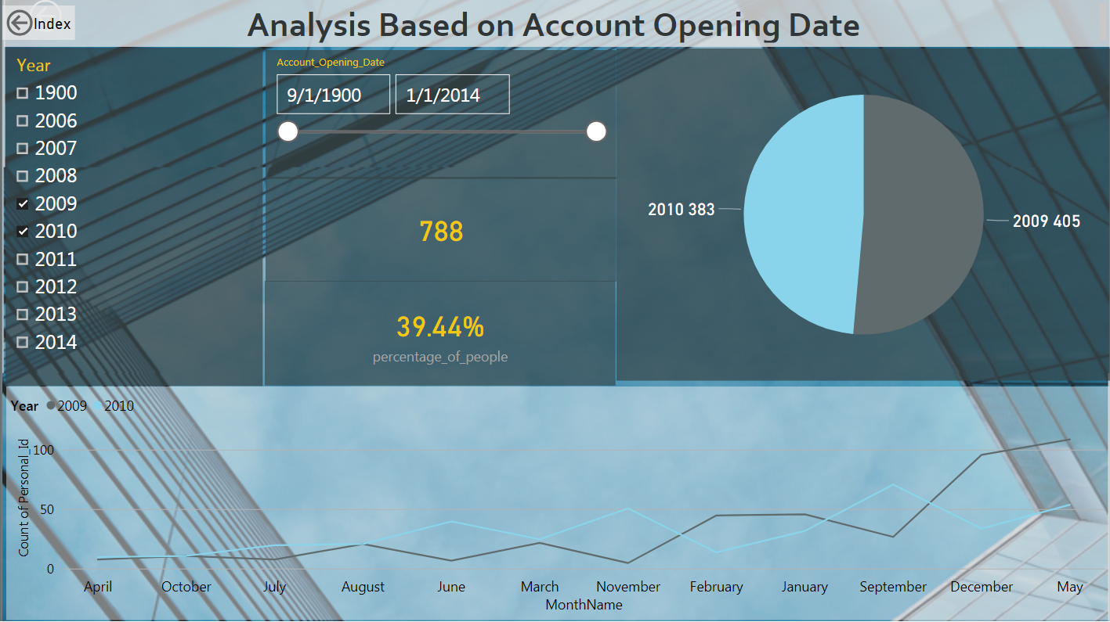

Slide 30

Any Queries?

Slide 31
Thank You

